Slide 1
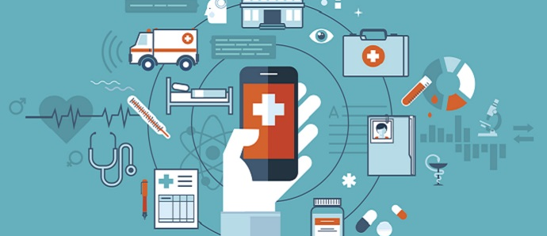
Mobile Application for Personal Diabetes Management By Cyprian Ampong Boateng – 10580360 Kwadwo Asamoa - 10576182

Slide 2
Aims
The Proposed System aims at helping patients in:
Easy logging of medical records
Easy tracking of diabetes progress
Connecting patients to diabetes Specialists
Helping patients maintain good quality and healthy life

Slide 3
Objectives
The proposed system seeks to
Help patients log, update and delete their medical records easily.
Use self explanatory and flexible charts to display patient’s medical records(blood sugar level, blood pressure, weight etc.)
Use push notifications to prompt patients and their specialists when patient’s conditions are above maximum or below minimum

Slide 4
Objectives Cont..
The proposed system seeks to
Use push notifications to prompt patients and their specialist when scheduled loggings are not met.
Connect patients and diabetes specialists in the form of chat messages, prescriptions and appointment schedules.
Provide the necessary information and updates on diabetes.

Slide 5
Modules of the Application
Medical Records Logging
Personal Assistant
Progress Tracking
Patient – Practitioner Communication
Notifications

Slide 6
Medical Records Logging
Entry of medical data such as
Blood Sugar level
Insulin dosage
Weight
Blood pressure
Cholesterol
Ketones
HA1C

Slide 7
Personal Assistant
Guidance tips and education on diabetes
Preferred diets and exercises
Location of nearby hospitals using google maps
Medications management

Slide 8
Progress Tracker
Displays medical data such as glucose level, blood pressure, HA1C using charts
Displays progress bar indicating progress level of patient

Slide 9
Patient – Practitioner Communication
Drug prescription by practitioner
Chat communication between patient and practitioner

Slide 10
Notification
Patient and practitioner are notified when patient fails to log records
Patient and practitioner are notified when progress levels drop below normal
SMS is sent to when app is offline

Slide 11
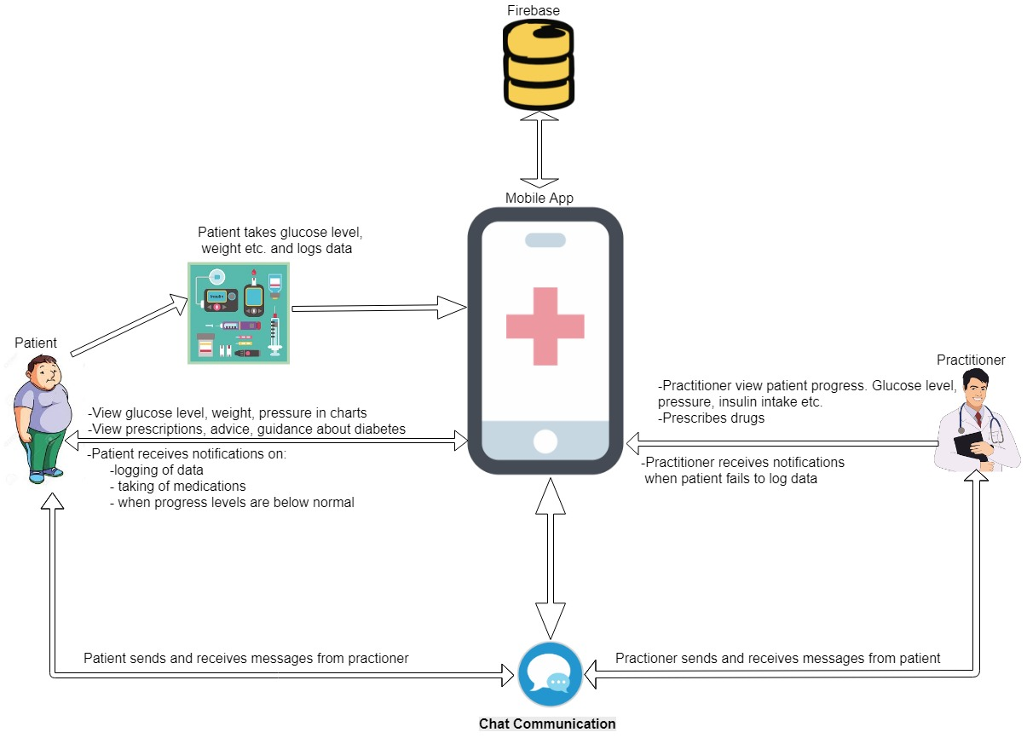
Architecture

Slide 12

Project Progress
Screenshots of progress made on project

Slide 13
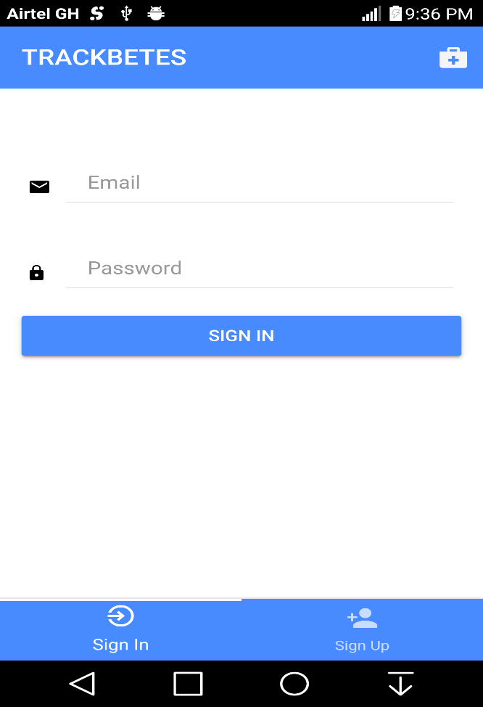
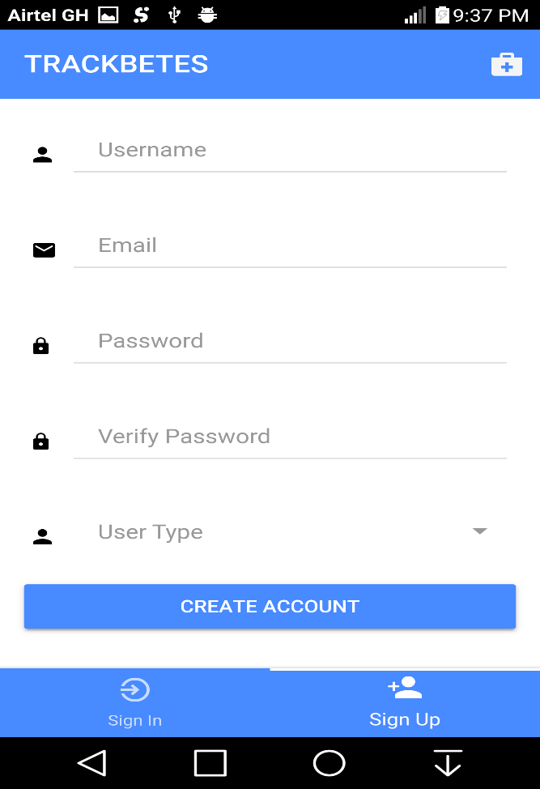
User Authentication
Sign In
Sign Up

Slide 14
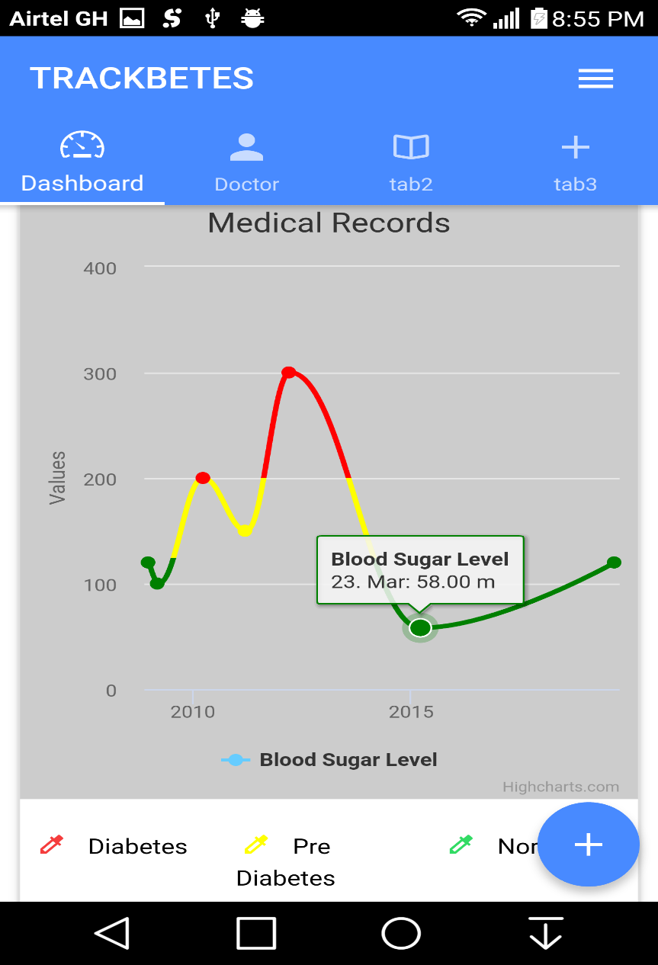
Patient Dashboard

Slide 15
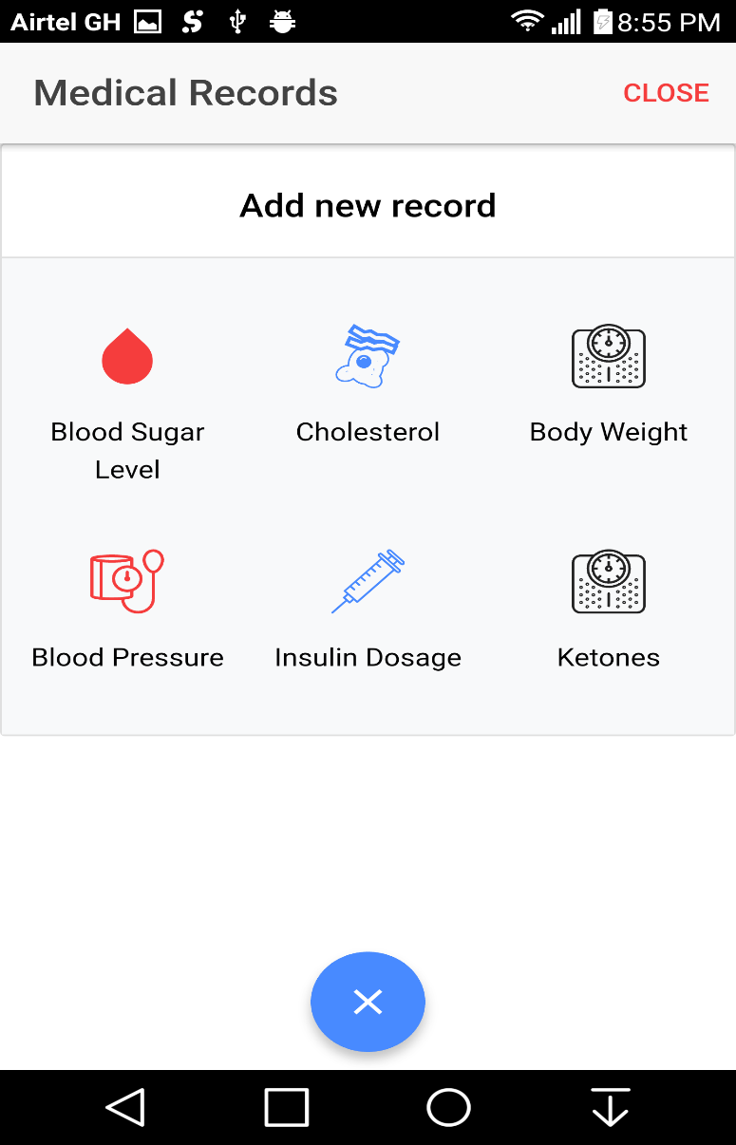
Medical Records Logging

Slide 16
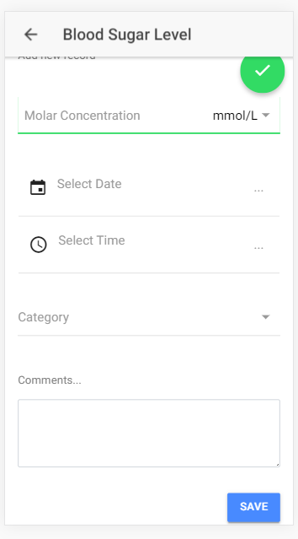
Blood Glucose Logging

Slide 17
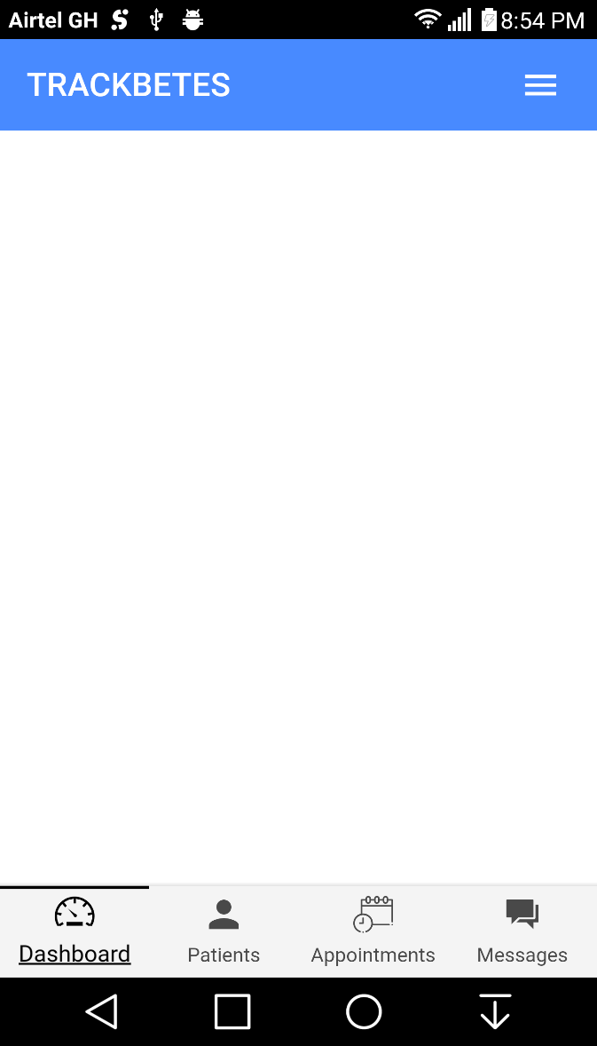
Doctor Dashboard

Slide 18
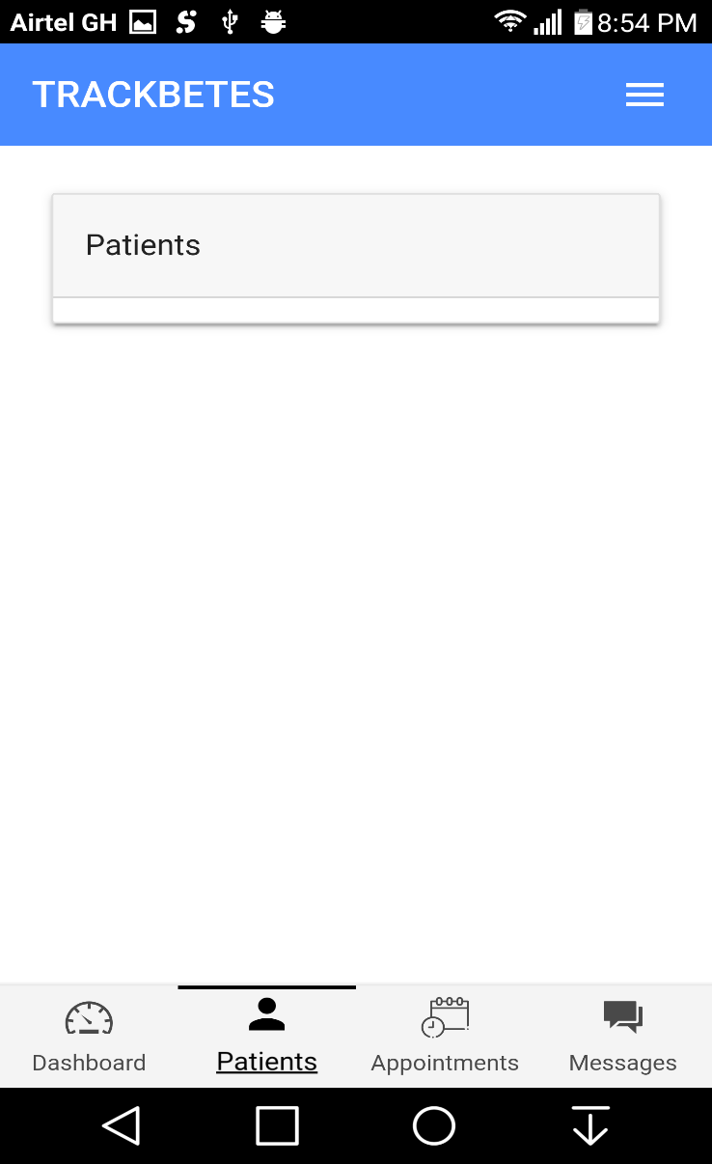
Doctor Patients

